Slide 1
Advanced Systems Analysis and Design The Systems Analyst and Information Systems Development SOFT 30121 L2 Presented By Nigel King ACMA CGMA PCM Nigel.King@ntu.ac.uk

Slide 2

The Systems Analyst and
Information Systems Development
RecoSystems Analysis and Design
Alan Dennis; Barbara Haley Wixom; Roberta M. Roth
2019
Chapter 1

Slide 3
The Big Picture
Planning Phase
The Systems Analyst and Information Systems Development
Analysis Phase
Design Phase
Implementation Phase

Slide 4
The Systems Analyst and Information Systems Development
Objectives of Lecture 2
Explain the role played in IS development by the systems analyst.
Describe the fundamental systems development life cycle and its four phases.
Explain how organizations identify IS development projects.
Explain the importance of linking the IS to business needs.
Be able to create a system request.
Describe technical, economic, and organizational feasibility assessment.
Be able to perform a feasibility analysis.
SOURCE: RecoSystems Analysis and Design
Alan Dennis; Barbara Haley Wixom; Roberta M. Roth
2019
Chapter 1

Slide 5
The Systems Analyst and Information Systems Development
The role played in IS development by the systems analyst.
The systems development life cycle (SDLC) is the process of determining how an information system (IS) can support business needs, designing the system, building it, and delivering it to users.
Lots of software projects end up on the rocks.
Qantas, the Australian national airline, has endured two high-profile IT failures in recent years. In 1995, Project eQ, a 10-year technology services contract with IBM, was canceled after four years, at a cost of $200 million.
Understanding steps in the SDLC really helps keeping the ship on course.
SOURCE: RecoSystems Analysis and Design
Alan Dennis; Barbara Haley Wixom; Roberta M. Roth
2019
Chapter 1

Slide 6
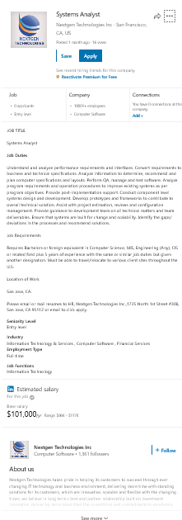
The Systems Analyst and Information Systems Development
The role played in IS development by the systems analyst.
The systems analyst plays a key role in the SDLC,
analyzing the business situation,
identifying opportunities for improvements,
designing an IS to implement the improvements.
Many systems analysts view their profession as one of the most interesting, exciting, and challenging jobs around.
SOURCE: RecoSystems Analysis and Design
Alan Dennis; Barbara Haley Wixom; Roberta M. Roth
2019
Chapter 1

Slide 7
The Systems Analyst and Information Systems Development
The importance of linking the IS to business needs.
Don’t get attracted to shiny new objects. Balance keeping what you know works with avoiding technical obsolescence.
Always be prepared to defend the business need in the systems that you are developing. Companies should be treating their IT projects as a portfolio of investments.
If you take your eye off, how you bring value to the business, your career will be short.
SOURCE: RecoSystems Analysis and Design
Alan Dennis; Barbara Haley Wixom; Roberta M. Roth
2019
Chapter 1

Slide 8
Systems Analyst Skills
Skills can be broken down into six major categories:
technical,
business,
analytical,
interpersonal,
management,
ethical.

Slide 9
Systems Analyst Roles
Systems Analyst
Business Analyst
Requirements Analyst
Infrastructure Analyst
Architect
Project Manager

Slide 10
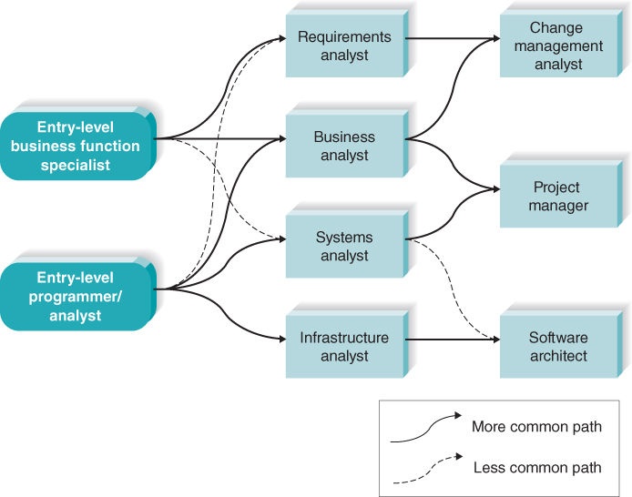
Systems Analyst Roles Progression

Slide 11
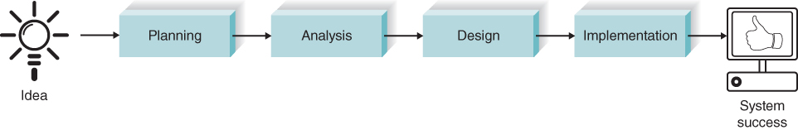
The Systems Development Life Cycle
Phase | Week | Step | Technique | Deliverable
Planning | 1 | Identify opportunity | Project identification | System request
Focus: Why build this system? | 1 | Analyze feasibility | Technical feasibility Economic feasibility Organizational feasibility | Feasibility study

Slide 12
Planning
The planning phase is the fundamental process of understanding why an IS should be built and determining how the project team will go about building it. It has two steps:
Record a system request.
A system request presents a brief summary of a business need and explains how a system that addresses the need will create business value. Conduct a feasibility analysis.
The feasibility analysis examines key aspects of the proposed project:
The technical feasibility (Can we build it?)
The economic feasibility (Will it provide business value?)
The organizational feasibility (If we build it, will it be used?)
The system request and feasibility analysis are presented to an IS approval committee (sometimes called a steering committee), which decides whether the project should be undertaken

Slide 13
Project Identification and Initiation
Where do project ideas come from?
A project is identified when someone in the organization identifies a business need to build a system.
Examples of business needs include supporting a new marketing campaign, reaching out to a new type of customer
Business Needs can arise from:
emerging technology, eg Mobile Apps
business process management (BPM) initiatives, eg improved process alignment with industry “best practices”
The business need drives the high-level business requirements for the system
Once the project sponsor identifies a project that meets an important business need and he or she can identify the business requirements and business value of the system.

Slide 14
System Request
In most organizations, project initiation begins by preparing a system request
Element | Description | Examples
Project Sponsor | The person who initiates the project and who serves as the primary point of contact for the project on the business side | Several members of the finance department Vice president of marketing CIO CEO
Business Need | The business-related reason for initiating the system | Reach a new market segment Offer a capability to keep up with competitors Improve access to information Decrease product defects Streamline supply acquisition processes
Business Requirements | The new or enhanced business capabilities that the system will provide | Provide onIine access to information Capture customer demographic information Include product search capabilities Produce performance reports Enhance online user support
Business Value | The benefits that the system will create for the organization | 3% increase in sales 1% increase in market share Reduction in headcount by 5 FTEs $200,000 cost savings from decreased supply costs $150,000 savings from removal of outdated technology
Special Issues or Constraints | Issues that pertain to the approval committee’s decision | Government-mandated deadline for May 30 System needed in time for the Christmas holiday season Top-level security clearance needed by project team to work with data
FTE, full-time equivalent.

Slide 15
System Request Example
System Request—Client Services Project
Project Sponsor: Carmella Herrera, General Manager, Client Services Business Unit Business Need: This project has been initiated to create the capability of clients requesting drone flight service and data analysis through the company website. The capability is an essential element in the business model of the newly formed Client Services business unit. Business Requirements: Using this system from our company website, clients will be able to request specific drone flight services and data analysis. A request will be offered to any contracted DrōnTeq drone pilots in the vicinity, who can submit bids during the bidding window. Once the bidding window closes, the pilot with the “winning“ bid will be assigned the request. Business Value: The Client Services business unit has been formed to enable clients who do not have a need for actual drone ownership to receive drone flight service and data analysis promptly and cost effectively. As a new business unit, we must estimate additional revenue from two streams: additional drone pilots who contract with DrōnTeq and lease a drone; and clients who contract for specific drone flight service and data analysis. Conservative estimates of tangible value to the business unit include $357,500 in revenue from new pilot contracts and drone leases $565,000 in revenue from drone flight service and data analysis Special Issues or Constraints: The capabilities described in the Business Requirements are essential to the business model for the Client Services Business Unit. This project is necessary for the new business unit’s operations.

Slide 16
Implementing a Satellite Data Network
A major retail store spent $24 million dollars on a large, private satellite communication system that provides state-of-the-art voice, data, and video transmission between stores and regional headquarters. When an item gets sold, the scanner software updates the inventory system in real time. As a result, store transactions are passed on to regional and national headquarters instantly, which keeps inventory records up to date. One of the store’s major competitors has an older system in which transactions are uploaded at the end of a business day. The first company feels that its method of instant communication and feedback allows it to react more quickly to changes in the market, giving the company a competitive advantage. For example, if an early winter snowstorm causes stores across the upper Midwest to start selling high-end (and high-profit) snow throwers quite quickly, the company’s nearest warehouse can prepare next-day shipments to maintain a good inventory balance, while the competitor may not move quite as quickly and thus lose out on such quick inventory turnover.
Questions Do you think a $24 million investment in a private satellite communication system could be justified by a cost–benefit analysis?
Could this be done with a standard communication line (with encryption)? How might the competitor attempt to close the “information gap” in this example?

Slide 17
Feasibility Analysis
Once the need for the system and its business requirements have been defined, the approval committee authorizes the systems analyst to prepare a more detailed business case to better understand the proposed IS project. Feasibility analysis guides the organization in determining whether to proceed with the project.
Technical Feasibility: Can We Build It?
Familiarity with application: Less familiarity generates more risk.
Familiarity with technology: Less familiarity generates more risk.
Project size: Large projects have more risk.
Compatibility: The harder it is to integrate the system with the company’s existing technology, the higher the risk will be.

Slide 18
Feasibility Analysis
Once the need for the system and its business requirements have been defined, the approval committee authorizes the systems analyst to prepare a more detailed business case to better understand the proposed IS project. Feasibility analysis guides the organization in determining whether to proceed with the project.
Economic Feasibility: Should We Build It?
Development costs
Annual operating costs
Annual benefits (cost savings and/or increased revenues)
Intangible benefits and costs

Slide 19
Example of costs and benefits for economic feasibility.
Development Costs | Operational Costs
Development team salaries Consultant fees Development training Hardware and software Vendor installation Office space and equipment Data conversion costs | Software upgrades Software licensing fees Hardware repair and upgrades Cloud storage fees Operational team salaries Communications charges User training
Tangible Benefits | Intangible Benefits
Increased sales Reductions in staff Reductions in inventory Reductions in IT costs Better supplier prices | Increased market share Increased brand recognition Higher-quality products Improved customer service Better supplier relations

Slide 20
Feasibility Analysis
Once the need for the system and its business requirements have been defined, the approval committee authorizes the systems analyst to prepare a more detailed business case to better understand the proposed IS project. Feasibility analysis guides the organization in determining whether to proceed with the project.
Organizational Feasibility: If We Build It, Will They Come?
Is the project strategically aligned with the business?
Project champion(s)
Senior management
Users
Other stakeholders

Slide 21
Important stakeholders for organizational feasibility.
 | Role | To Enhance Organizational Feasibility
Champion | A champion: Initiates the project Promotes the project Allocates his or her time to the project Provides resources | Make a presentation about the objectives of the project and the proposed benefits to those executives who will benefit directly from the system. Create a prototype of the system to demonstrate its potential value.
Organizational Management | Organizational managers: Know about the project Budget enough money for the project Encourage users to accept and use the system | Make a presentation to the management about the objectives of the project and the proposed benefits. Market the benefits of the system, using memos and organizational newsletters. Encourage the champion to talk about the project with his organizational newsletters or her peers.
System Users | Users: Make decisions that influence the project Perform hands-on activities for the project Ultimately determine whether the project is successful using or not using the system | Assign users official roles on the project team. Assign users specific tasks to perform, with clear deadlines. Ask for feedback from users regularly (e.g., at weekly meetings).

Slide 22
Example Feasibility Analysis
Client Services Project Executive Summary Carmella Herrera and Jiang Tsaio created the following feasibility analysis for the DrōnTeq Client Services Project. The System Request is attached, along with the detailed feasibility study. The highlights of the feasibility analysis are as follows:
Technical Feasibility
The Client Services project is feasible technically, although there is some risk.
DrōnTeq’s risk regarding familiarity with a customer-facing drone service request system is moderate.
The Sales Department uses a customer-facing system to allow customers to configure and place orders for commercial drone purchases. This system was developed by the DrōnTeq IS department.
The Client Service business model contains an unfamiliar element—the use of a bidding approach to obtain offers from pilots and determine the winning bid based on multiple factors.
Business user involvement will be essential.
DrōnTeq’s risk regarding familiarity with the technology is low.
The IT department has extensive knowledge of the current Web-based customer order system and the databases and Internet technology it uses.
The technology used in the proposed Client Services Project will be very similar to existing systems.
The project size is considered moderately low.
Project scope has been deliberately limited to the front-end of this overall system: customer request, pilot notification, pilot bidding, and flight assignment.
The project team will likely consist of five or fewer people.
The compatibility with DrōnTeq’s existing technical infrastructure should be good.
An Internet infrastructure is already in place at corporate headquarters.
The system will be based on existing technology infrastructure currently supporting the Sales Department.

Slide 23
Example Feasibility Analysis
Client Services Project Executive Summary Carmella Herrera and Jiang Tsaio created the following feasibility analysis for the DrōnTeq Client Services Project. The System Request is attached, along with the detailed feasibility study. The highlights of the feasibility analysis are as follows:.
Economic Feasibility
A cost–benefit analysis was performed; see the attached spreadsheet for details (provided in Appendix 1A). Conservative estimates show that the Client Services project has a good chance of enhancing the company’s bottom line.
ROI over 3 years: 43%
NPV over 3 years: $675,818
Break-even occurs after 1.62 years
Intangible Costs and Benefits
Enhanced competitive position through expansion of our drone brand into the drone flight service market. Clients who don’t wish to own and operate their own drones will still have a convenient and cost–effective way to receive the benefits provided from our drone flights and data analysis services.

Slide 24
Example Feasibility Analysis
Client Services Project Executive Summary Carmella Herrera and Jiang Tsaio created the following feasibility analysis for the DrōnTeq Client Services Project. The System Request is attached, along with the detailed feasibility study. The highlights of the feasibility analysis are as follows:
Organizational Feasibility
From an organizational perspective, this project has moderately high risk.
Top management support: The top executives of the company strongly support the project.
Project champion: Carmella Hererra is a respected and knowledgeable business executive.
Organizational management: Overall, managers throughout DrōnTeq support the creation of the new business unit. The Sales department, however, may experience some drone sales loss as some prospective customers choose to purchase drone flight services rather than purchase and operate drones themselves.
Customers: Customers will expect a user interface that is clear and simple to use. Customers will want to enter basic facts one time and have those facts stored securely. This will enable them to request repeat flight services quickly and easily. Customers will expect prompt response and accurate status information on all flight service requests. Without these features, customers may be unwilling to use this service.
Pilots: Pilots will depend on this system to provide notification of potential drone flights, bid on flights, and receive flight assignments; therefore, pilots will demand a system that is quick and easy to use and that embodies a fair and consistent bidding and flight assignment mechanism. Otherwise, pilots will reject the business model of the Client Services business unit and the venture’s success is doubtful.
Additional Comments
The top executives view this as a strategic system. This system will allow us to extend our drone services to a new audience. Our marketing research tells us this market is strong and we believe the services will be well accepted.
To enhance acceptance of the new service, the introduction of the system should coincide with the agricultural growing season since agricultural users are a primary audience.

Slide 25
The Systems Analyst and Information Systems Development
Review of Lecture 2
Explain the role played in IS development by the systems analyst.
Describe the fundamental systems development life cycle and its four phases.
Explain how organizations identify IS development projects.
Explain the importance of linking the IS to business needs.
Be able to create a system request.
Describe technical, economic, and organizational feasibility assessment.
Be able to perform a feasibility analysis.
SOURCE: RecoSystems Analysis and Design
Alan Dennis; Barbara Haley Wixom; Roberta M. Roth
2019
Chapter 1

Slide 26
The Systems Analyst and Information Systems Development
Summary of Lecture 2
Systems Analysts require broad skills
Systems Analysis is a career path, not just a job.
A software development lifecycle progresses through planning, analysis, design and implementation.
Planning further decomposes into steps
Identify Project Candidates
Develop a System Request
Analyse Technical Feasibility
Analyse Economic Feasibility
Analyse Organizational Feasibility
SOURCE: RecoSystems Analysis and Design
Alan Dennis; Barbara Haley Wixom; Roberta M. Roth
2019
Chapter 1

Slide 27
Next Lecture
Project Selection and Management

